Slide 1
FY2021 Budget: Initial Allotment Presentation
Agenda
Budget Timeline
Preliminary Enrollment
Initial Allotments
Certification & Experience
Appendix
Engage. Inspire. Prepare.
February 25, 2020
Version 3.0

Slide 2
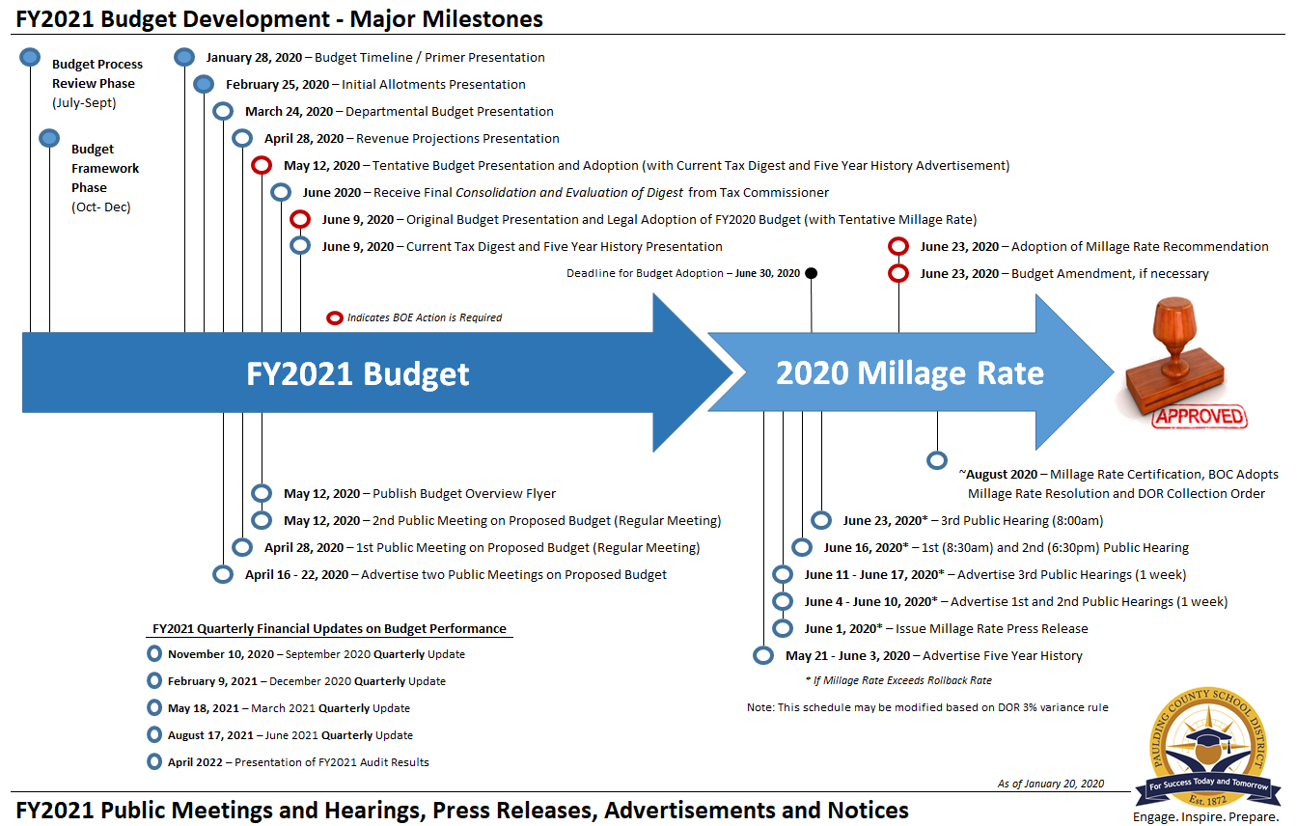
FY2021 Budget Approval Timeline
February 25, 2020
Initial Allotment Presentation
1 | Budget Timeline

Slide 3
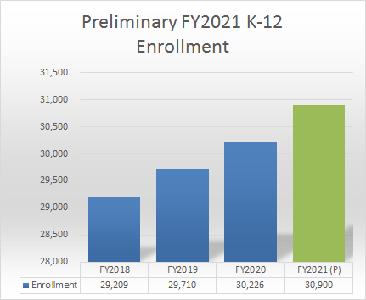
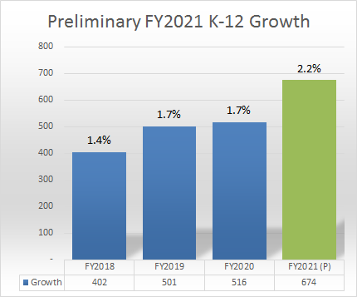
Preliminary Enrollment Growth
Please Note: These are preliminary numbers and will be influenced by Kindergarten Registration, School Choice, Programs, etc.
2 | Enrollment
Notes:
Details are in the Appendix

Slide 4
FY2020 Current Allotments
65% or 2,360
Total Instruction
Allotment Count as of February 6, 2020
3 | Allotments

Slide 5
Initial Allotment Changes
General Fund Rational
GenEd Class Sizes (52):
Kindergarten at 21.6 : 1
Grades 1-3 at 22.6 : 1
Grades 4-8 at 28.6 : 1
Grades 9-12 at 22.5 : 1
School-Based Allotment Assumptions (4) (see Appendix)
School-Based ESEP (22)
Other Direct Instruction & Support (12):
Curriculum/Improvement
ESEP
Divisions (10)
3 | Allotments
Notes:
Chart Location: QBE T&E

Slide 6
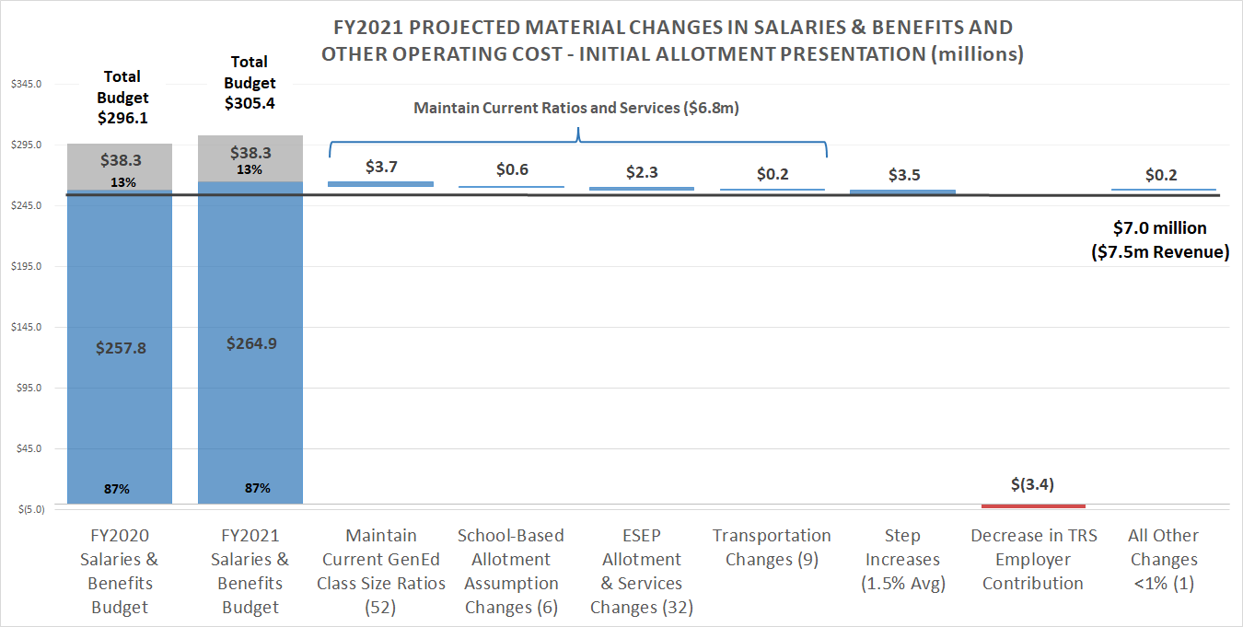
Financial Impact of Allotment Changes
Maintain Current Ratios & Services. The initial cost projections to maintain class size ratios, school-based allotments, ESEP services and transportation totals over $6.8 million, excluding the impact of a potential $2,000 adjustment to the State’s teacher pay scales.
3 | Allotments
Notes:
Chart Location: QBE T&E

Slide 7
QBE Certification & Experience
T&E Certification
31% Bachelor
37% Masters
28% Specialist
69% Advanced
T&E Experience
22% 9-14 Years
25% 15-20 Years
26% +21 Years
73% > 8 Years
Based on October 2019 CPI Count, FY21 QBE
4 | Certification & Experience

Slide 8
FY2021 Budget Approval Timeline
March 24, 2020
Departmental Budget Presentation
1 | Budget Timeline

Slide 9
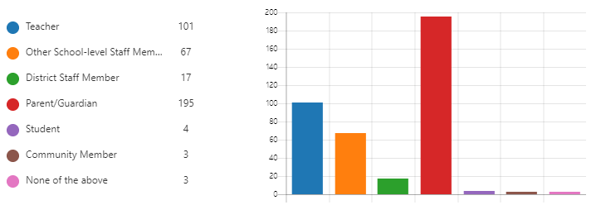
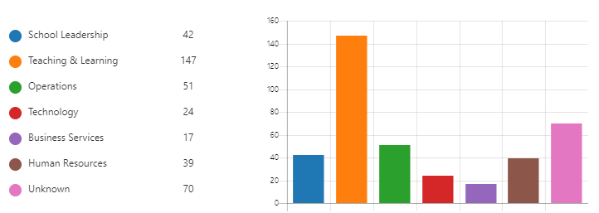
Feedback Statistics
390 Responses
50% Parent/Guardian
26% Teacher
Division
38% Teaching & Learning
13% Operations
Budget Area
36% Instruction
21% Salary/Benefits
Budget Impact
54% Increase
5% Decrease
41% Neutral
As of February 19, 2020
FY2021 Budget Feedback
Notes:
4.1 / 5.0 (210, with 78 suggestions)

Slide 10
Thank You For Budget Ideas and Feedback Visit our Website (Budget Feedback)
Engage. Inspire. Prepare.

Slide 11
Appendix
Engage. Inspire. Prepare.

Slide 12
Expenditure Comparison / Allotments
2,360 (70%)
109 (3%)
174 (5%)
53 (2%)
206 (6%)
352 (10%)
110 (3%)
Excludes SNP
Appendix
Notes:
School Focus: Instruction, Pupil Services, Improvement of Instruction, Media and School Admin (

Slide 13
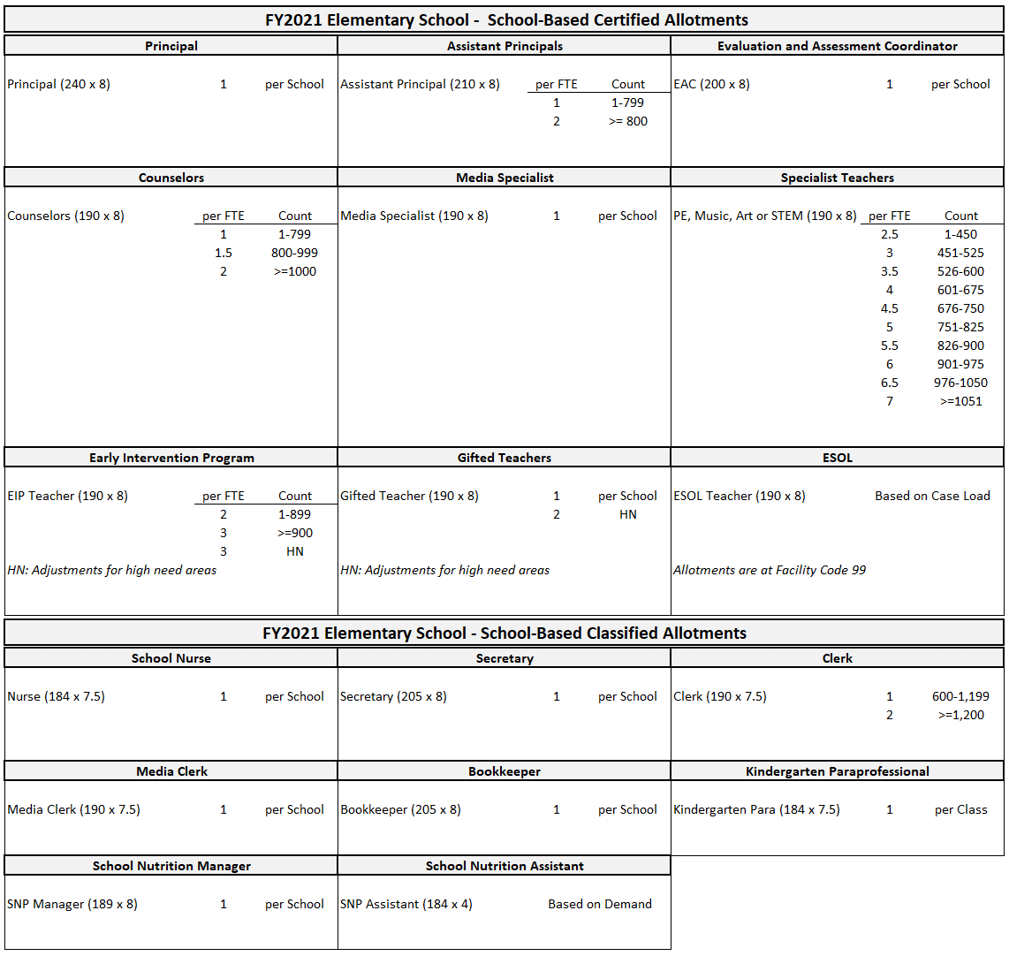
School-Based Allotment Assumptions
Appendix

Slide 14
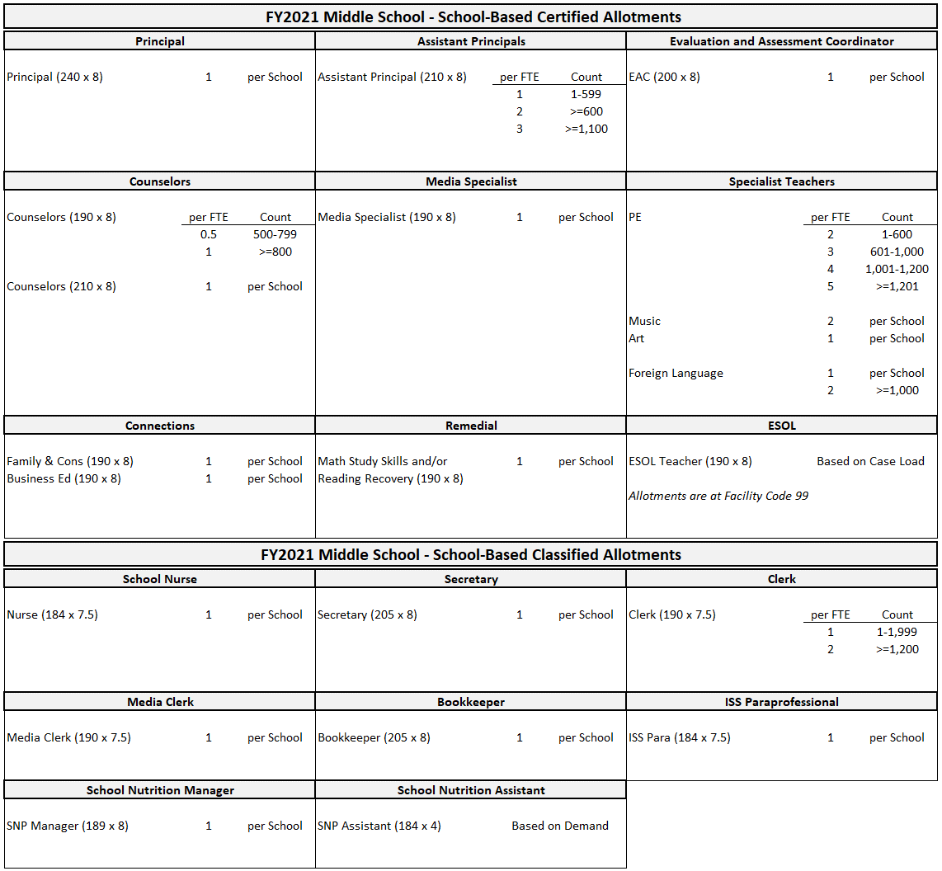
School-Based Allotment Assumptions
Appendix

Slide 15
School-Based Allotment Assumptions
Appendix

